Slide 1
Project Presentation of Industry Oriented Hands on Experience (22CS422)
On
An Efficient CNN-Based Framework for Automated Blood Cell Classification in Hematological Disease Diagnosis
Name of Student1 : Ravinder Singh(ID:2210992144) Name of Student2 : Rishav Nath Kaura(ID:2210992160)
Name of Student3 : Rajat Chauhan(ID: 2210992131)
Supervised By :
Dr. Preeti Saini
Department of Computer Science and Engineering,
Chitkara University, Punjab

Slide 2
INTRODUCTION
This project presents an efficient CNN-based framework for automated blood cell classification in hematological disease diagnosis using deep learning techniques. Traditional microscopic analysis of blood smear images is often manual, time-consuming, subjective, and prone to human error, making accurate diagnosis challenging.
To overcome these limitations, the proposed system uses a Convolutional Neural Network (CNN) model to automatically classify blood cell images into four categories: Benign, Malignant Pre-B, Malignant Pro-B, and Malignant Early Pre-B. The framework incorporates image preprocessing, feature extraction, and deep learning-based classification to accurately identify malignant blood cell patterns.
The model achieved high classification accuracy along with strong precision, recall, and F1-score performance across all classes. In addition, training-validation analysis and confusion matrix evaluation demonstrate the reliability and generalization capability of the proposed CNN model. By enabling rapid, accurate, and automated blood cell analysis, the framework can assist clinicians in improving hematological disease diagnosis and reducing dependency on manual microscopic examination.
2

Slide 3
OBJECTIVE
The objective of this project is to design and develop an efficient CNN-based framework for automated blood cell classification in hematological disease diagnosis using deep learning techniques. The system aims to accurately classify microscopic blood cell images into four categories: Benign, Malignant Pre-B, Malignant Pro-B, and Malignant Early Pre-B.
The proposed framework focuses on automatically extracting important morphological features from blood cell images through convolutional neural networks (CNNs) to improve classification accuracy and reduce dependency on manual microscopic analysis. It also aims to enhance the speed, consistency, and reliability of blood cancer diagnosis by minimizing human error and subjective interpretation.
Ultimately, the goal is to support clinicians and healthcare professionals with a fast, accurate, and intelligent diagnostic support system for hematological disease detection.

Slide 4
PROBLEM STATEMENT
Traditional blood cell classification and hematological disease diagnosis mainly depend on manual microscopic examination performed by medical experts. This process is time-consuming, labor-intensive, and prone to human error, especially when analyzing large numbers of blood smear images. In many cases, the visual differences between benign and malignant blood cells are very subtle, making accurate diagnosis difficult and sometimes inconsistent.
Additionally, variations in cell shape, staining, illumination, and image quality further increase the complexity of blood cell analysis. Existing manual methods often fail to provide fast, reliable, and scalable diagnostic support for early disease detection such as leukemia. Therefore, there is a strong need for an intelligent and automated deep learning-based system that can accurately classify blood cell images, reduce diagnostic workload, and improve the efficiency and reliability of hematological disease diagnosis.

Slide 5
METHODOLOGY
The methodology of this project follows a CNN-based deep learning approach for automated blood cell classification. Initially, microscopic blood cell images are collected from the Kaggle ALL Challenge Dataset (ISBI 2019). The images are then preprocessed using resizing and normalization techniques to improve image quality and maintain consistency.
After preprocessing, a Convolutional Neural Network (CNN) model is developed using convolution, max-pooling, batch normalization, dropout, and dense layers to extract important features from blood cell images. The model classifies images into four categories: Benign, Malignant Pre-B, Malignant Pro-B, and Malignant Early Pre-B.
Finally, the trained model is evaluated using accuracy, precision, recall, F1-score, and confusion matrix analysis to measure the performance and reliability of the proposed framework.

Slide 6
FEATURES
1. CNN-Based Blood Cell Classification Uses a Convolutional Neural Network (CNN) to accurately classify blood cell images.
2. Automated Disease Detection Automatically identifies benign and malignant blood cell patterns for faster diagnosis.
3. Four-Class Classification Classifies blood cells into Benign, Malignant Pre-B, Malignant Pro-B, and Malignant Early Pre-B categories.
4. Image Preprocessing Applies resizing and normalization techniques to improve image quality and consistency.
5. High Classification Accuracy Achieves high accuracy, precision, recall, and F1-score for reliable performance.
6. Clinical Decision Support Assists healthcare professionals in accurate and efficient hematological disease diagnosis.

Slide 7
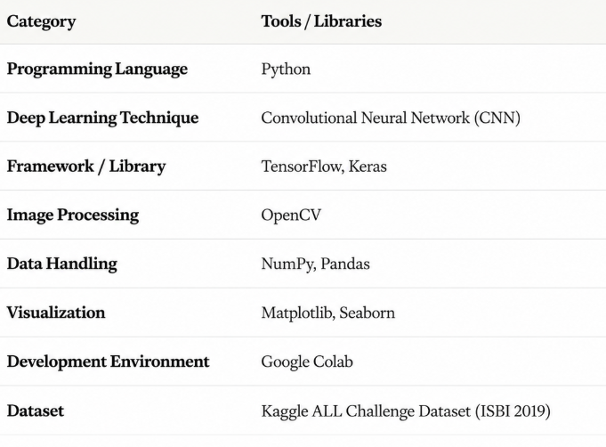
Technology Stack

Slide 8
OUTCOMES
• High Classification Accuracy — The proposed CNN model achieved an overall accuracy of 98.76% in classifying blood cell images into four categories.
• Accurate Blood Cell Classification — The model effectively classified blood cells into Benign, Malignant Pre-B, Malignant Pro-B, and Malignant Early Pre-B classes with high precision and recall.
• Strong CNN Performance — Training and validation analysis showed stable learning with minimal overfitting and strong generalization capability.
• Reliable Confusion Matrix Results — The confusion matrix demonstrated very low misclassification among blood cell classes, especially for malignant categories.
• Effective Feature Extraction — The CNN architecture successfully extracted important morphological features from microscopic blood cell images.
• Efficient Diagnostic Support — The framework provides a fast, automated, and reliable approach for hematological disease diagnosis and clinical decision support.

Slide 9
FUTURE SCOPE
• Larger Clinical Datasets — Use larger and more diverse blood cell image datasets
from hospitals and medical laboratories to improve model performance and reliability.
• Advanced Deep Learning Models — Integrate transfer learning and advanced
architectures such as ResNet, EfficientNet, and Vision Transformers for improved
classification accuracy.
• Enhanced Image Preprocessing — Apply advanced image enhancement and data
augmentation techniques to improve robustness against noise and image variations.
• Explainable AI Integration — Incorporate Explainable AI (XAI) methods to highlight
important regions in blood cell images for better clinical interpretability.
• Real-Time Clinical Deployment — Develop a real-time web or medical diagnostic
application for automated blood cell analysis in hospitals and laboratories.
• Multi-Disease Detection — Extend the framework to detect additional hematological
diseases such as anemia, lymphoma, and malaria.
• Improved Automation — Build a fully automated clinical decision support system to
assist healthcare professionals in faster and more reliable diagnosis.

Slide 10
CONCLUSION
This project successfully developed an efficient CNN-based framework for automated blood cell classification in hematological disease diagnosis using deep learning techniques. The proposed model accurately classified blood cell images into four categories: Benign, Malignant Pre-B, Malignant Pro-B, and Malignant Early Pre-B.
The CNN model achieved an overall classification accuracy of 98.76% along with high precision, recall, and F1-score values across all classes. Training and validation analysis demonstrated stable learning and strong generalization capability, while confusion matrix evaluation confirmed minimal misclassification among blood cell categories.
The proposed framework provides a fast, accurate, and reliable alternative to manual microscopic analysis and can effectively support clinicians in automated hematological disease diagnosis. Overall, the study demonstrates the significant potential of CNN-based systems in improving the efficiency and accuracy of medical image classification.

Slide 11
Thank You
11

